Slide 1


NoSQL Databases
Department of Computer Science Engineering
School of Engineering

Slide 2
Module 3 : Document Data Model Hands on: Mongo DB / Casandra
Topics: Install, Perform CRUD (create, read, update and delete) Operations, Aggregation, Data Models, Transactions, Indexes, Security, Replication, and Sharding.
[7 Hrs.] [Application]

Slide 3
Introduction
NoSQL (often interpreted as Not only SQL) database
It provides a mechanism for the storage and retrieval of data that is modeled in means other than the tabular relations used in relational databases.

Slide 4
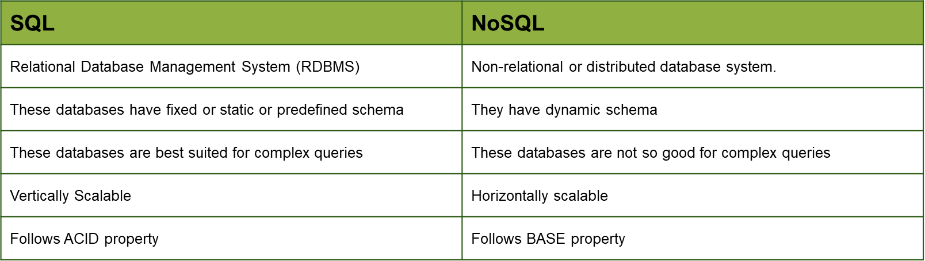
SQL Vs NoSQL

Slide 5
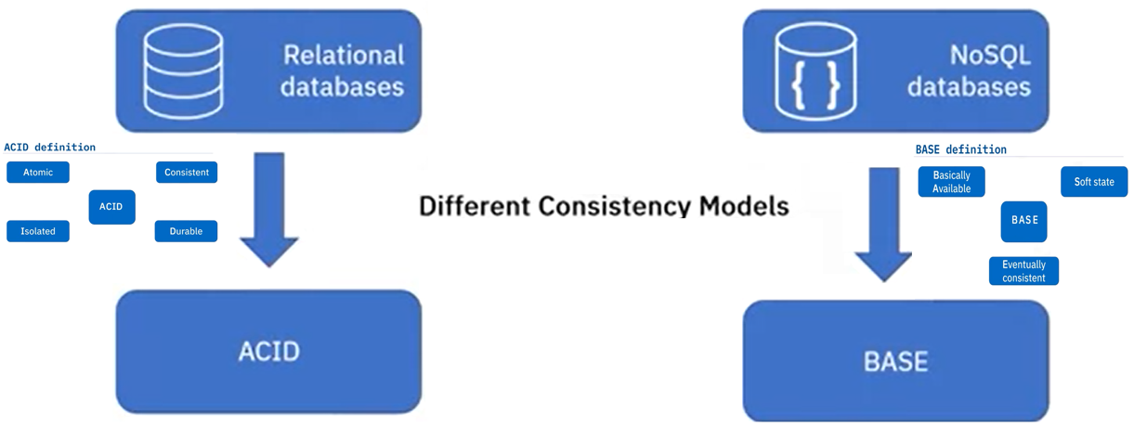
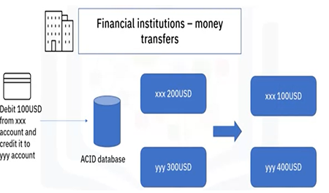
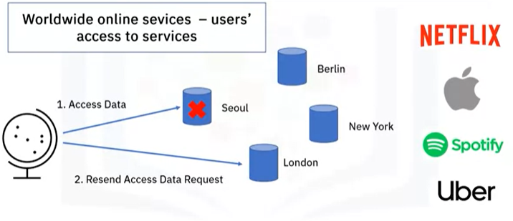
SQL Vs NoSQL (Cont’d…)

Slide 6
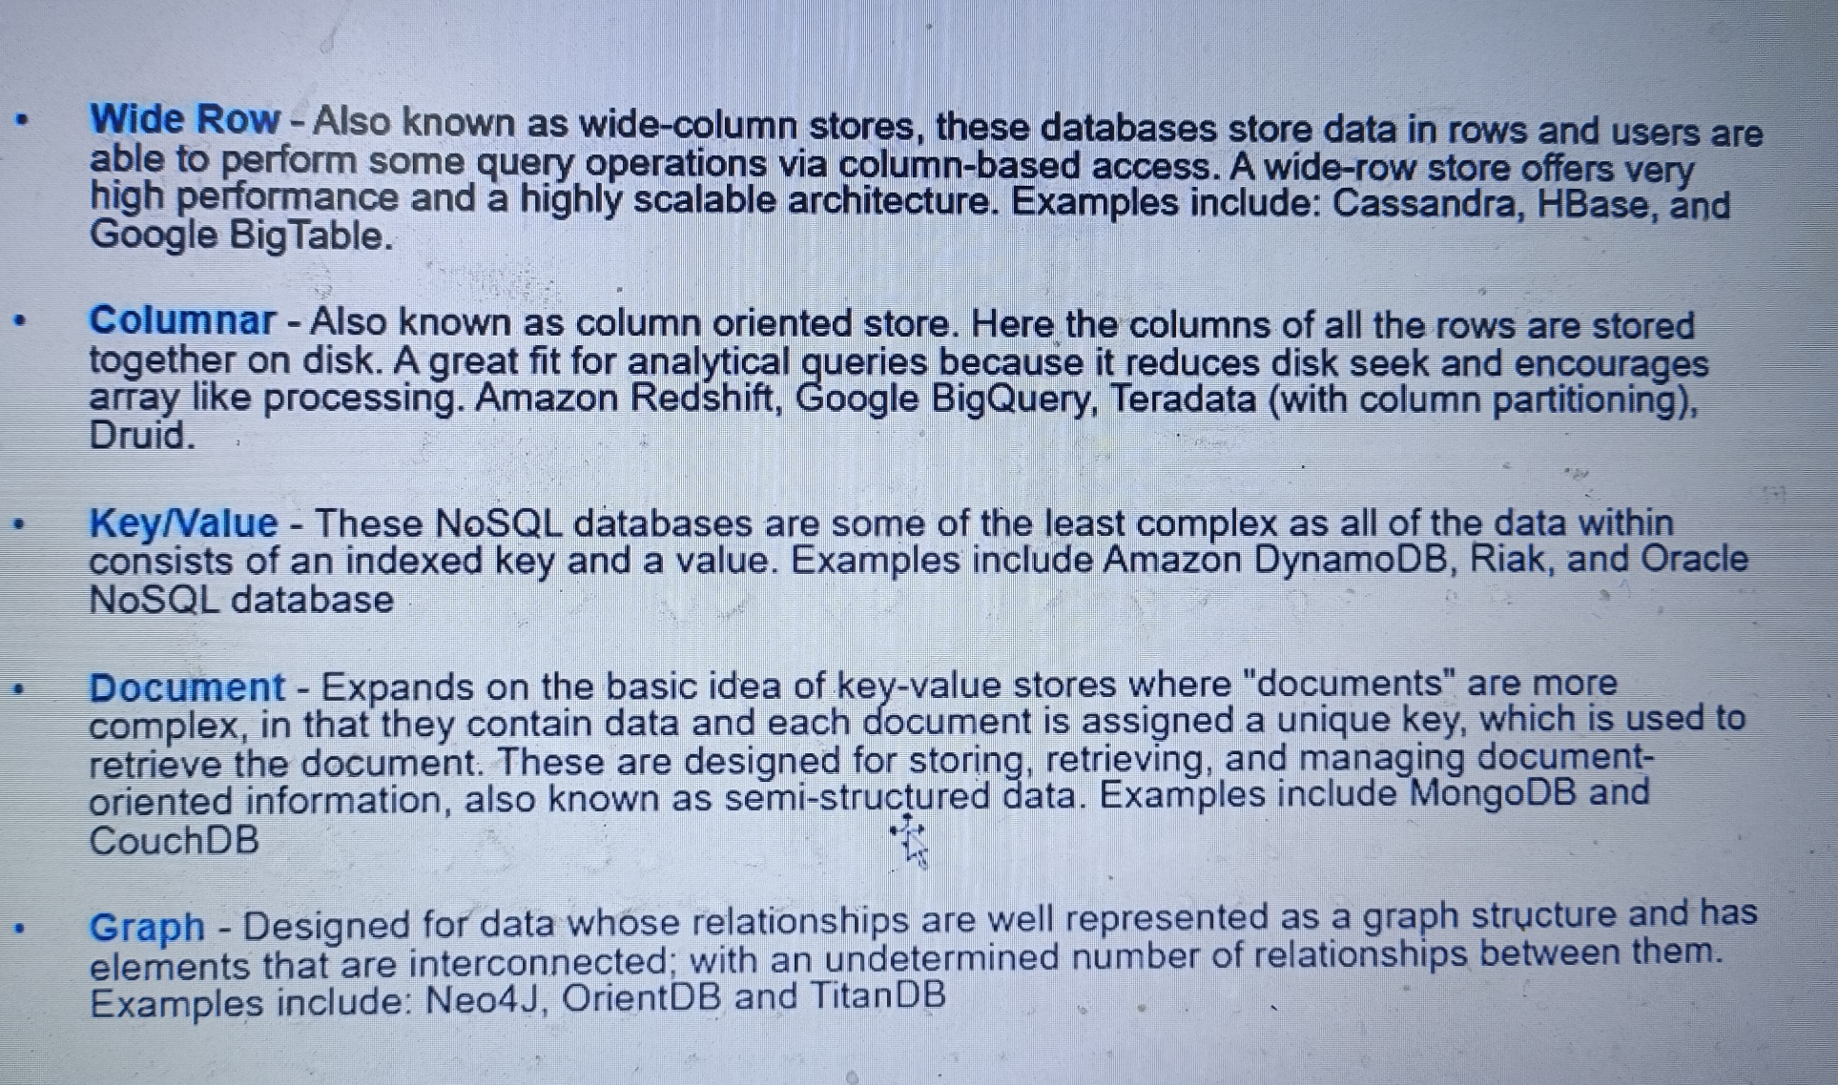
Types of NoSQL

Slide 7
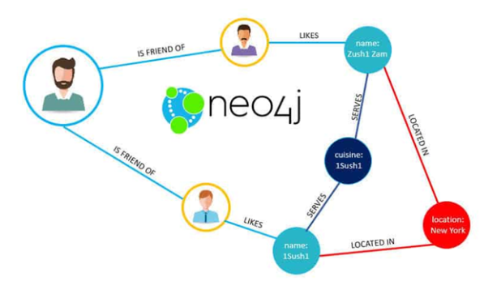


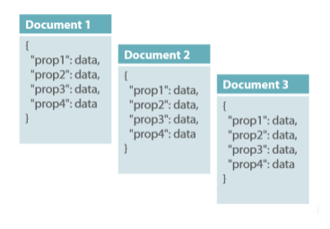


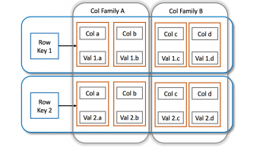


Types of NoSQL (Cont’d…)
Graph database
Document-oriented
Column family

Slide 8

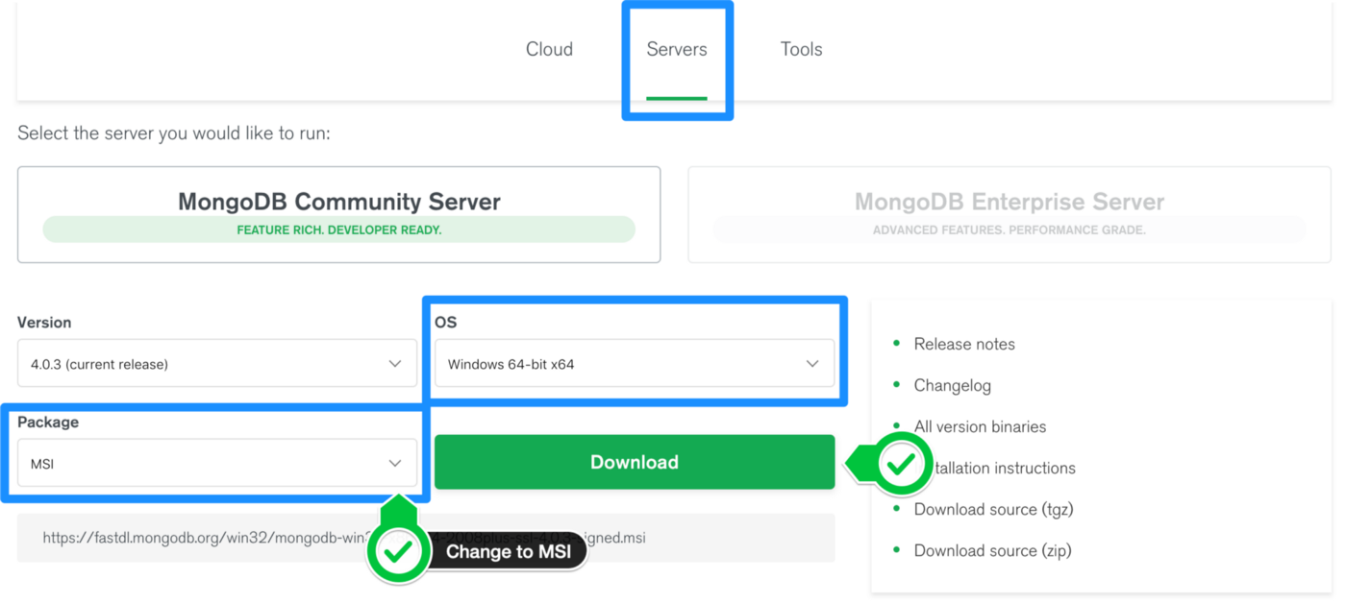
MongoDB Basic Installation
Step 1 — Download the MongoDB MSI Installer Package
Head over and download the current version of MongoDB. Make sure you select MSI as the package you want to download.

Slide 9
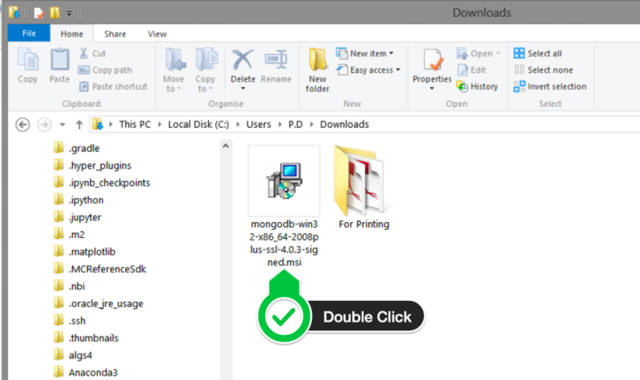
MongoDB Basic Installation (Cont’d…)
Step 2 — Install MongoDB with the Installation Wizard
A. Make sure you are logged in as a user with Admin privileges. Then navigate to your downloads folder and double-click on the .msi package you just downloaded. This will launch the installation wizard.

Slide 10
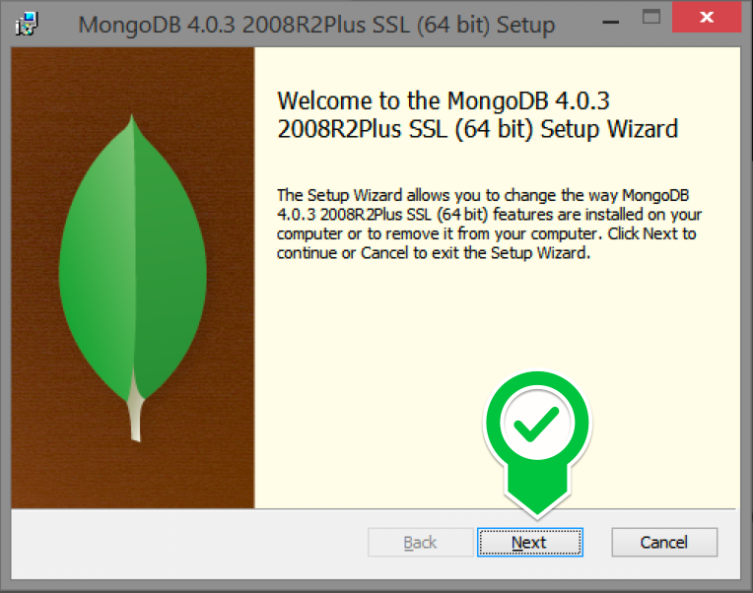
MongoDB Basic Installation (Cont’d…)
Step 2 — Install MongoDB with the Installation Wizard
B. Click Next to start installation

Slide 11
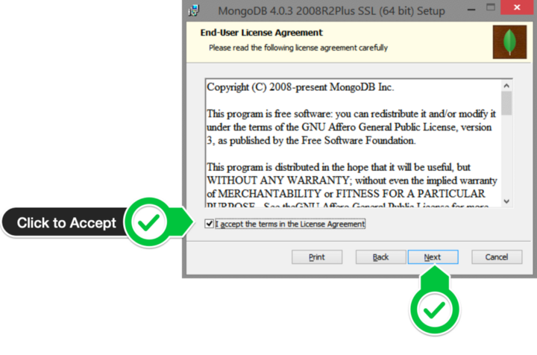
MongoDB Basic Installation (Cont’d…)
Step 2 — Install MongoDB with the Installation Wizard
C. Accept the licence agreement then click Next.

Slide 12
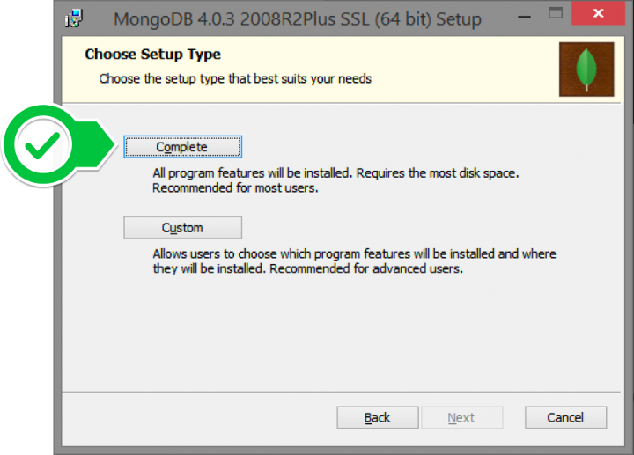
MongoDB Basic Installation (Cont’d…)
Step 2 — Install MongoDB with the Installation Wizard
D. Select the Complete setup..

Slide 13
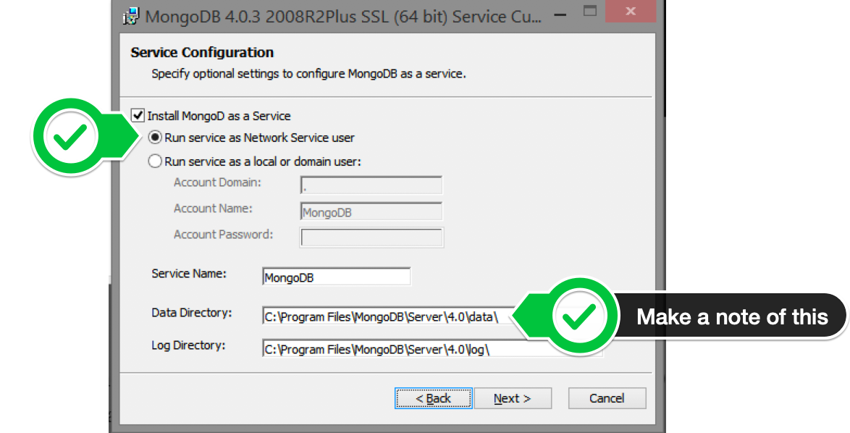
MongoDB Basic Installation (Cont’d…)
Step 2 — Install MongoDB with the Installation Wizard
E. Select “Run service as Network Service user” and make a note of the data directory, we’ll need this later.

Slide 14
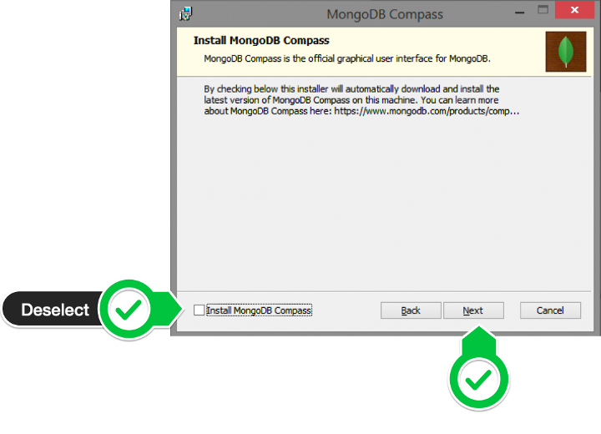
MongoDB Basic Installation (Cont’d…)
Step 2 — Install MongoDB with the Installation Wizard
F. We won’t need Mongo Compass, so deselect it and click Next.

Slide 15
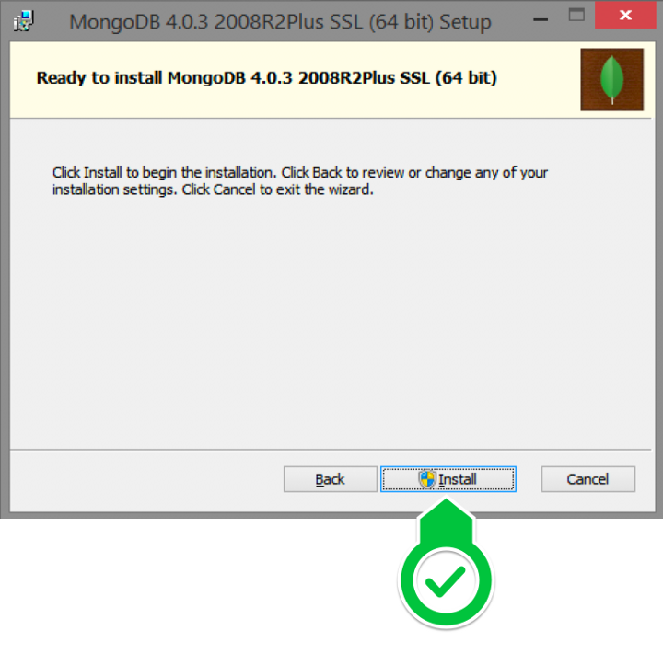
MongoDB Basic Installation (Cont’d…)
Step 2 — Install MongoDB with the Installation Wizard
G. Click Install to begin installation.

Slide 16
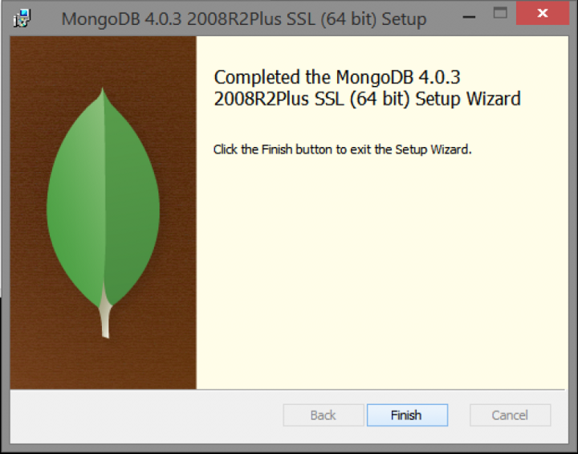
MongoDB Basic Installation (Cont’d…)
Step 2 — Install MongoDB with the Installation Wizard
F. Hit Finish to complete installation.

Slide 17
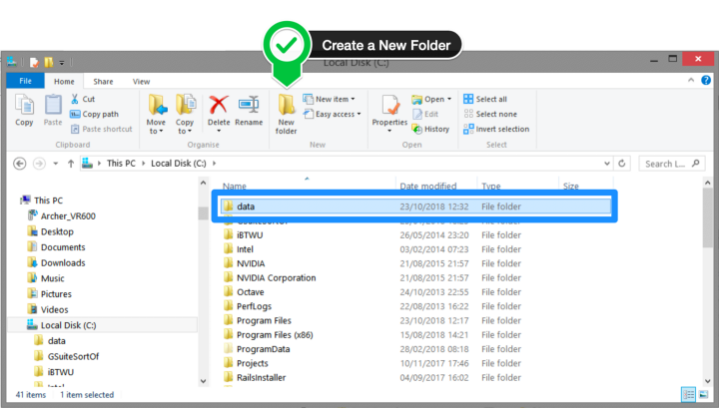
MongoDB Basic Installation (Cont’d…)
Step 3— Create the Data Folders to Store our Databases
A. Navigate to the C Drive on your computer using Explorer and create a new folder called data here.

Slide 18
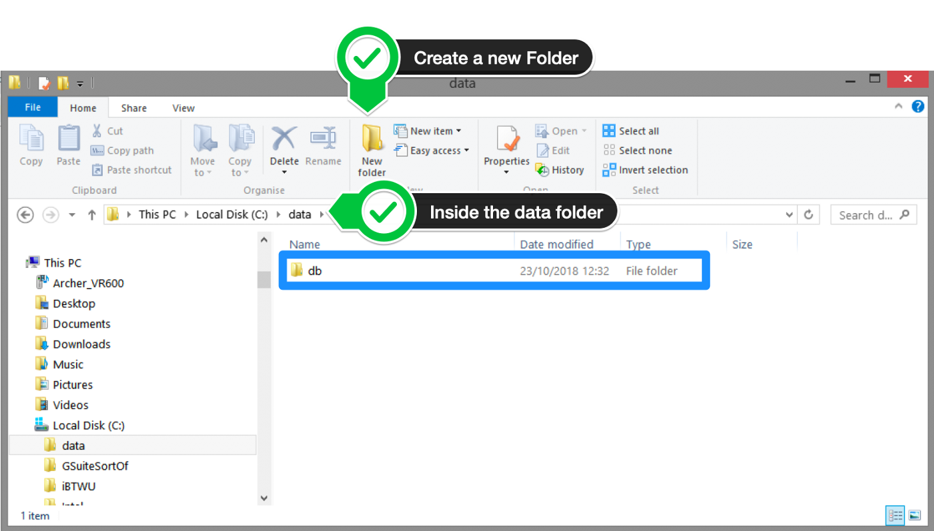
MongoDB Basic Installation (Cont’d…)
Step 3— Create the Data Folders to Store our Databases
B. Inside the data folder you just created, create another folder called db.

Slide 19
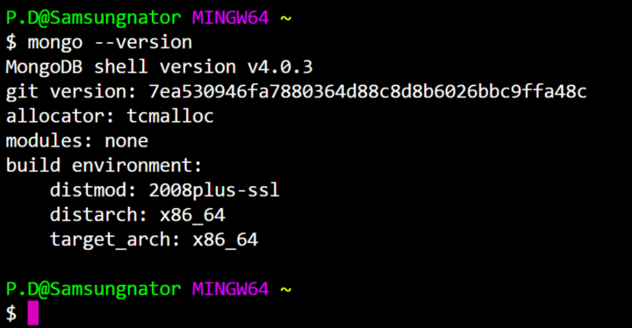
MongoDB Basic Installation (Cont’d…)
Step 4 — Verify That Setup was Successful
Type the following commands into the Command Prompt:
Mongo –version
Example :

Slide 20
What is MongoDB?
MongoDB is an open source, document-oriented database designed with both scalability and developer agility in mind.
Instead of storing your data in tables and rows as you would with a relational database, in MongoDB you store JSON-like documents with dynamic schemas(schema-free, schema less).

Slide 21
What is MongoDB? (Cont’d…)
Example:
{
"_id" : ObjectId("5114e0bd42…"),
“FirstName" : "John",
“LastName" : "Doe",
“Age" : 39,
“Interests" : [ "Reading", "Mountain Biking ]
“Favorites": {
"color": "Blue",
"sport": "Soccer“
}
}

Slide 22
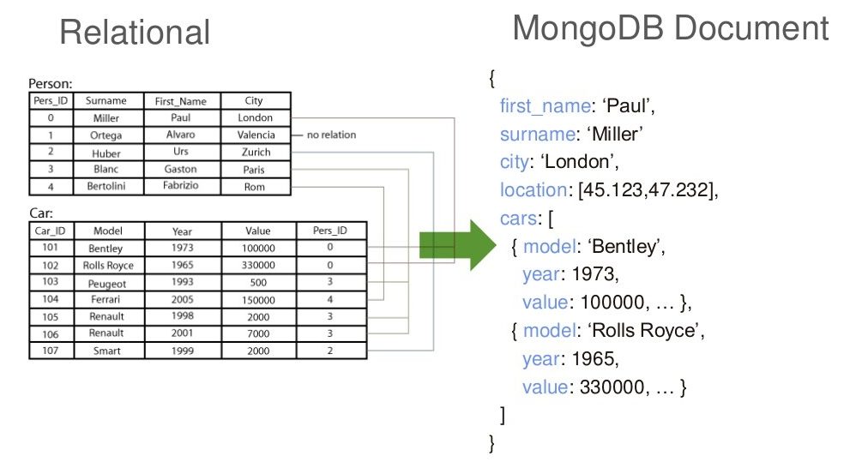
Easy to use MongoDB

Slide 23
Schema Free
MongoDB does not need any pre-defined data schema. Every document could have different data.
{name: “Ahamed”,
eyes: “blue”,
birthplace: “KA”,
aliases: [“nas”, “deen”],
loc: [32.7, 63.4],
boss: ”ben”}
{name: “jeff”,
eyes: “blue”,
loc: [40.7, 73.4],
boss: “ben”}
{name: “brendan”,
boss: “will”}
{name: “matt”,
weight:60,
height: 72,
loc: [44.6, 71.3]}
{name: “ben”,
age:25}

Slide 24
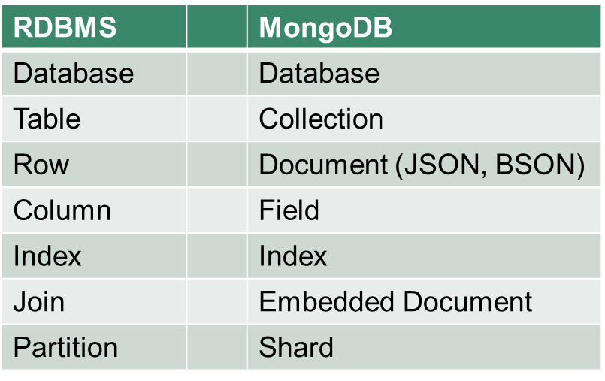
RDBMS Vs MongoDB

Slide 25
Features of MongoDB
Document-Oriented storage
Full Index Support
Replication & High Availability
Auto-Sharding
Aggregation
MongoDB Atlas
Various APIs
JavaScript, Python, Ruby, Perl, Java, Java, Scala, C#, C++, Haskell, Erlang
Community

Slide 26
CRUD (Create, Read, Update, Delete)
Create
db.collection.insert( <document> )
db.collection.save( <document> )
db.collection.update( <query>, <update>, { upsert: true } )
Read
db.collection.find( <query>, <projection> )
db.collection.findOne( <query>, <projection> )
Update
db.collection.update( <query>, <update>, <options> )
Delete
db.collection.remove( <query>, <justOne> )

Slide 27
CRUD (Create, Read, Update, Delete
Example:
> db.user.insert({
first: “Nasur",
last : “Ahamed”,
age: 30
})
> db.user.find ()
{
"_id" : ObjectId("51…"),
"first" : “Nasur",
"last" : “Ahamed",
"age" : 30
}

Slide 28
CRUD (Create, Read, Update, Delete
Example:
> db.user.update(
{"_id" : ObjectId("51…")},
{
$set: {
age: 30,
salary: 7000}
}
)
> db.user.remove({
"first": /^J/
})

Slide 29
MongoDB Aggregation
Aggregation: In programming, we often run a series of operations on a collection of items. Aggregation operations process data records and return computed results.
In MongoDB run operations on the server against our collections stored in the database before the result is returned to the client.

Slide 30
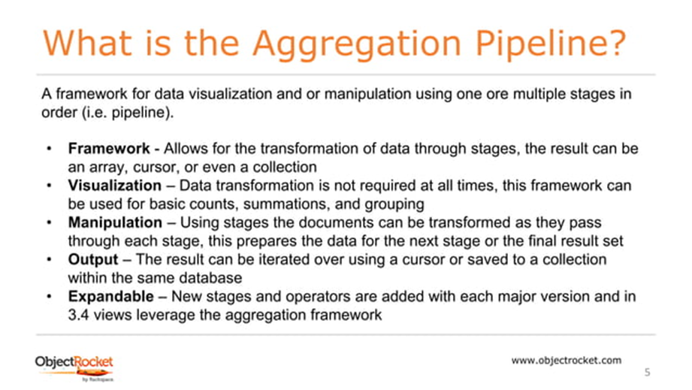
MongoDB Aggregation Pipeline

Slide 31
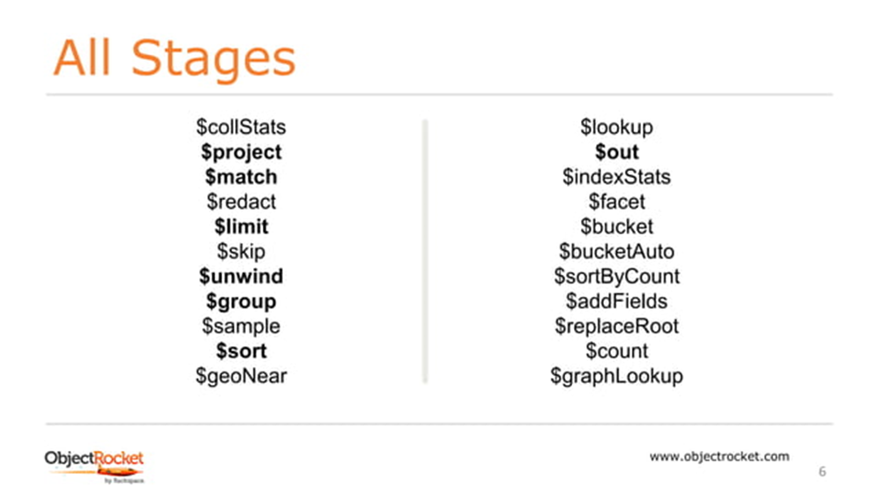
MongoDB Aggregation Pipeline – All Stages

Slide 32
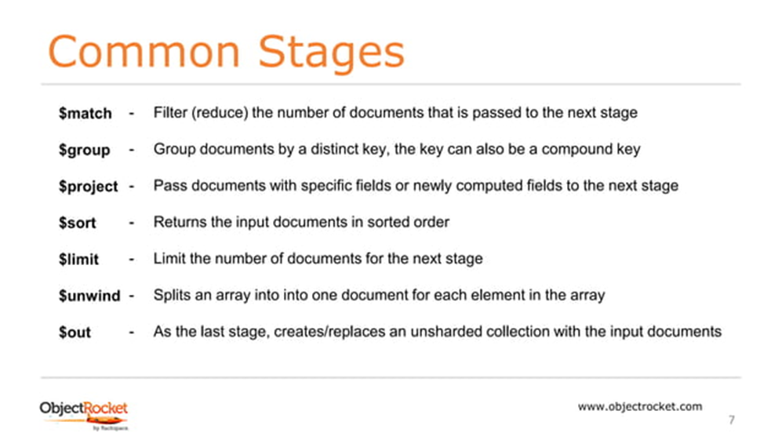
MongoDB Aggregation Pipeline – Common Stages

Slide 33
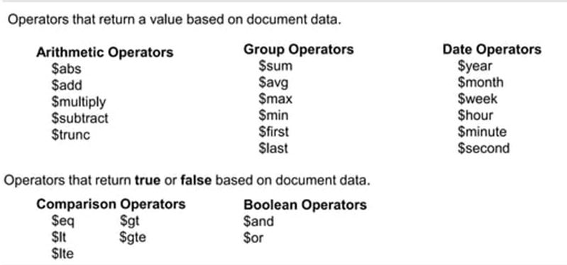
MongoDB Aggregation Pipeline – Common Operators

Slide 34
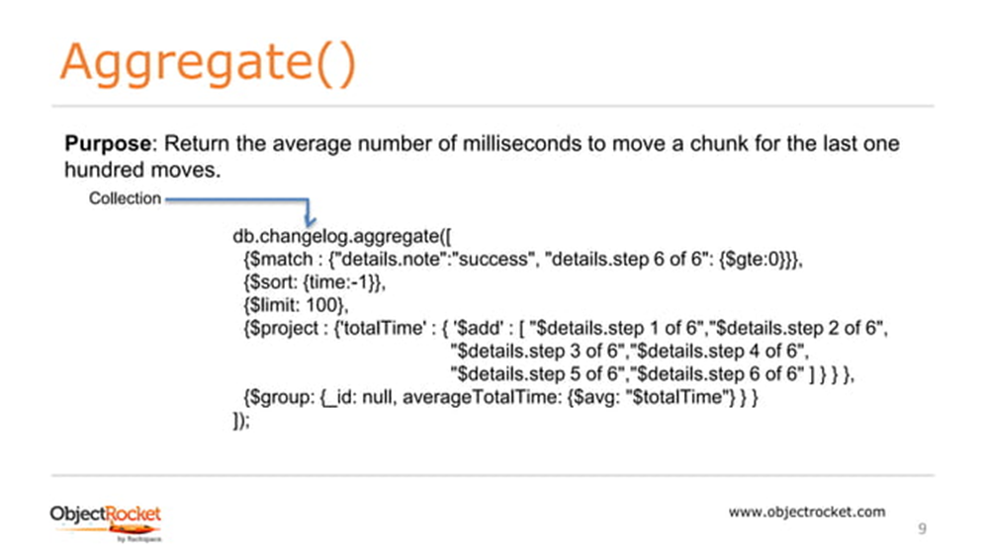
Aggregate()

Slide 35
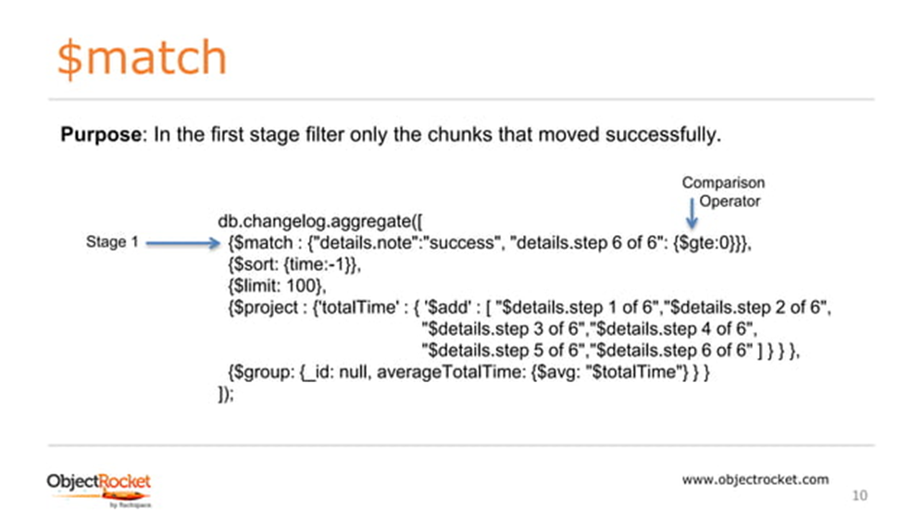
$match

Slide 36
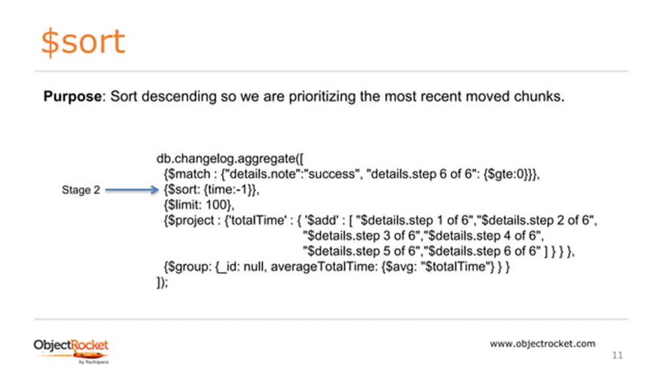
$sort

Slide 37
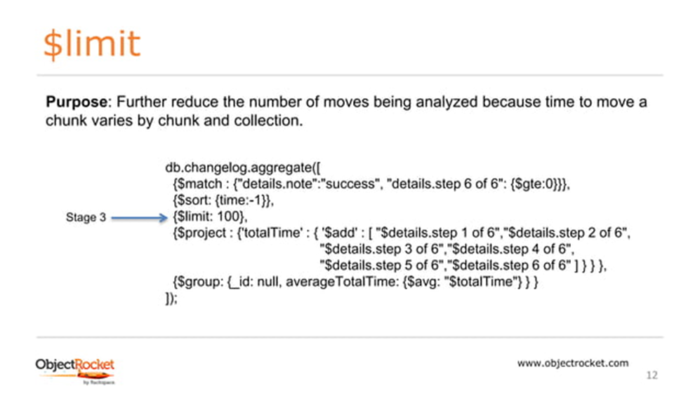
$limit

Slide 38
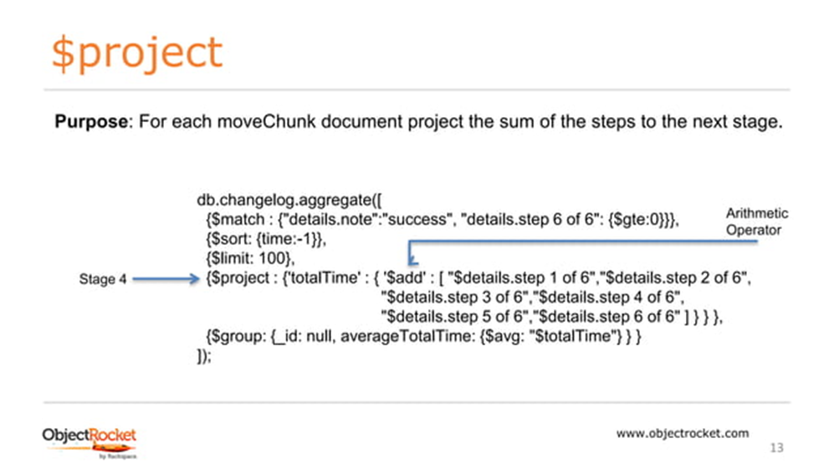
$project

Slide 39
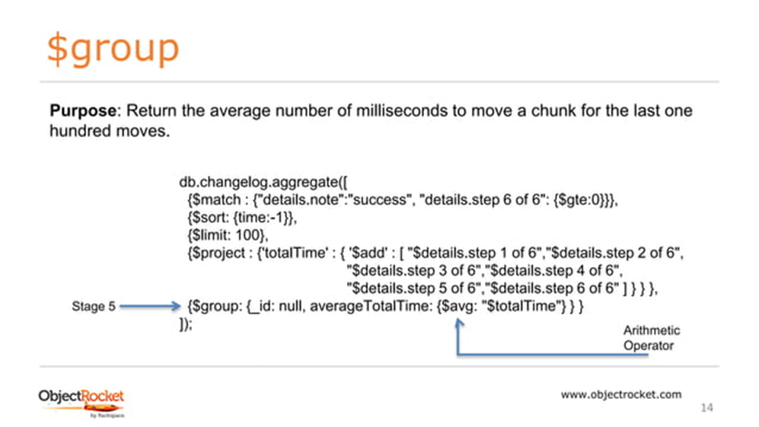
$group

Slide 40
Cassandra Aggregations
In Cassandra, aggregate functions are pre-defined or in-build functions. Some of the aggregate functions in Cassandra are mentioned below:
Count
Min and Max
Sum
Avg

Slide 41
Cassandra Aggregations : Count, Max and Min
Count: The count function is used to count the rows returned by a query.
Example: SELECT COUNT(1) FROM Emp_record;
Max and Min :
Max: The Max function is used to compute the maximum value returned by a query for a given column.
Min: The Min function is used to compute the minimum value returned by a query for a given column.
Example (Min): SELECT MIN(E_score) FROM Emp_record;
Example (Max): SELECT MAX(E_score) FROM Emp_record;

Slide 42
Cassandra Aggregations : Sum, AVG
Sum: The sum function is an aggregate function that can be used, to sum up all the values returned by a query for a given column.
Example: SELECT SUM(E_score) FROM Emp_record;
Avg: The avg function is an aggregate function which can be used to compute the average of all the values returned by a query for a given column..
Example (Max): SELECT AVG(E_score) FROM Emp_record;

Slide 43
MongoDB : Data Model
Definition: A data model is a visual representation of how you will store data, along with how the data is related to each other. The goal of creating a data model is to identify all the data components of a system and how they are linked together.
Types of Data Model:
Conceptual Data Model: The conceptual data model explains what the system should contain with regard to data and how it is related.
Logical Data Model: The logical data model will describe how the data will be structured.
Physical Data Model: The physical data model represents how the data will be stored in a specific database management system (DBMS).

Slide 44
Example : Conceptual Data Model
Library
Books: The library has millions of books, and they all have a unique International Standard Book Number (ISBN). The users will need to search books by title or by author.
Users: This library has thousands of users, and each user has a name, along with an address. The library will assign them a unique number that they can find on their library card.
Users will borrow books: Ultimately, the library will need to know which books have been borrowed by which user. Each user is entitled to five borrowed books at a time.

Slide 45
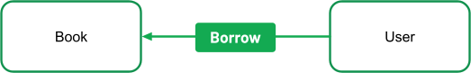
Example : Conceptual Data Model- Cont’d..
Library

Slide 46
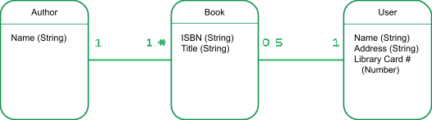
Example : Logical Model
It is now time to create a logical data model. As part of this modeling step, you might realize that some of your data structures are more complex and require new entities.
For example, the authors would be better represented as their own entities in order to enable searching for books by authors. We are assuming here that there is a single author per book for the sake of simplicity.

Slide 47
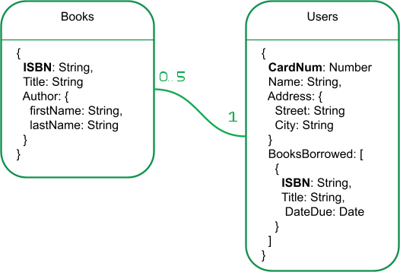
Example : Physical Data Model
It is now time to choose your DBMS and build your physical data model. At this point, you will start thinking in terms of the database you picked. The type of database you choose will determine how you will store the data.
If you use a document database, such as MongoDB, you will model relationships using embedding or document references. As you establish the relationships between your various objects, you will also find your IDs and unique values representing your items.

Slide 48
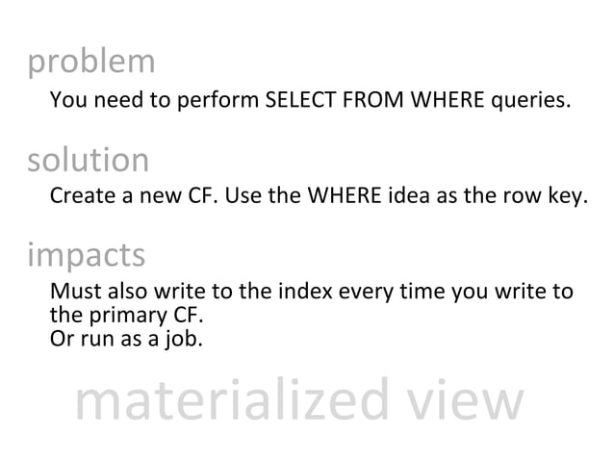
Cassandra : Data Model
Materialized View:
CF : Column Family

Slide 49
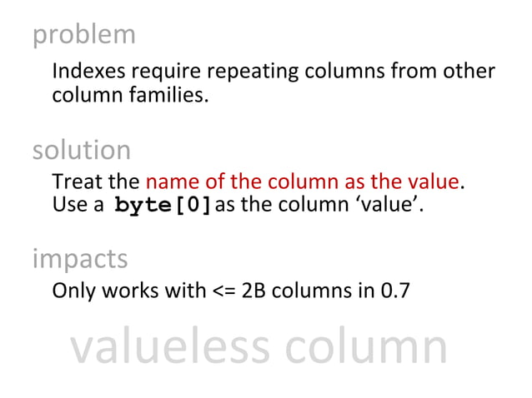
Cassandra : Data Model
Valueless Column:

Slide 50
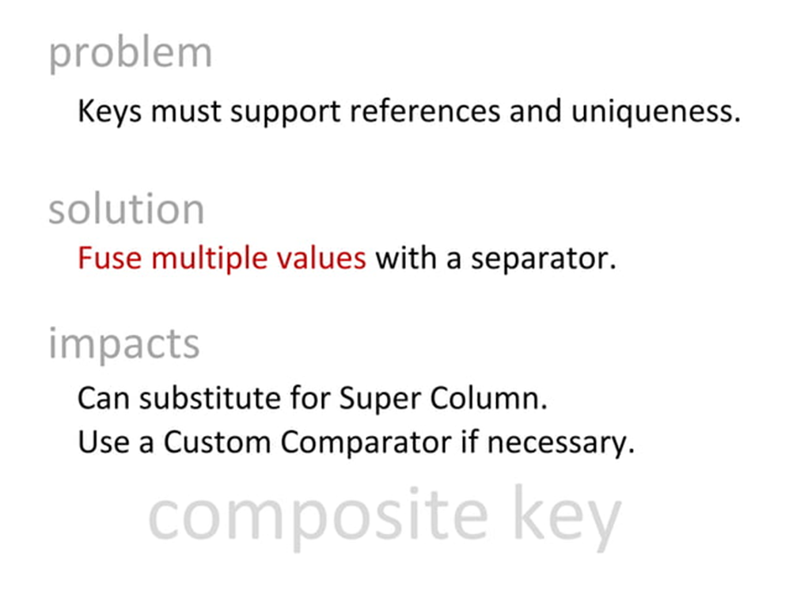
Cassandra : Data Model
Composite Key:

Slide 51
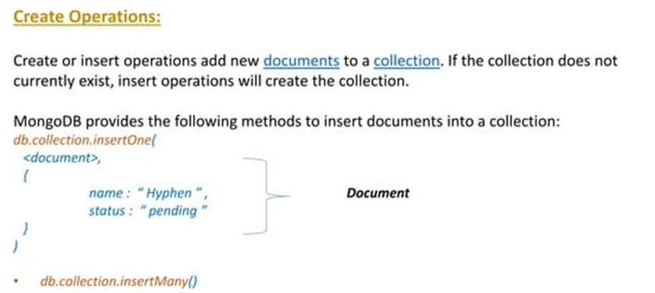
MongoDB Operations
CRUD: Create Read Update Delete

Slide 52
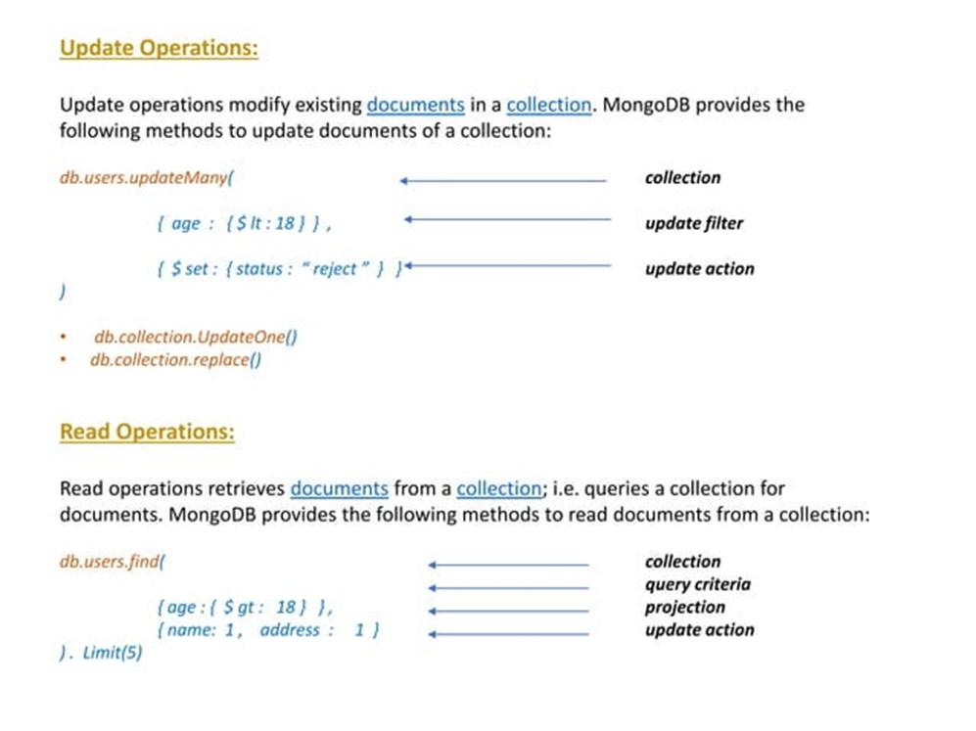
MongoDB Transactions
CRUD: Create Read Update Delete

Slide 53
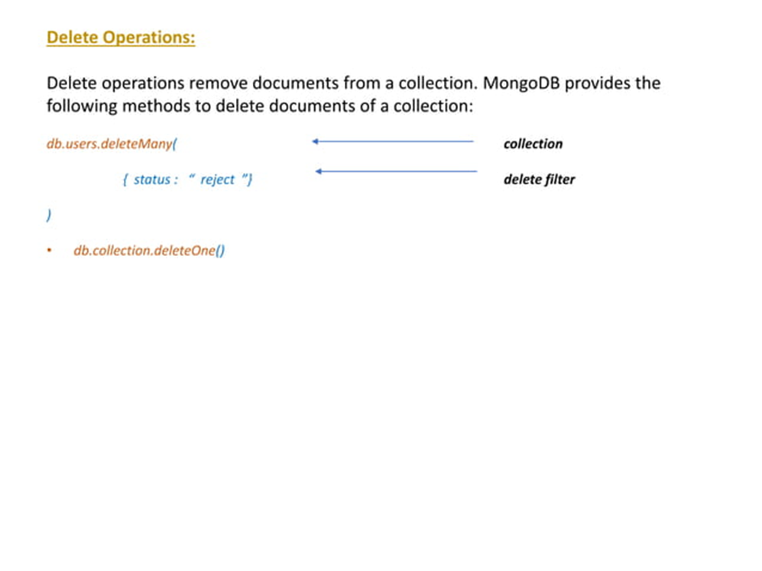
MongoDB Transactions
CRUD: Create Read Update Delete

Slide 54
Read Consistency
Data Store that maintains update consistency does not guarantee that all readers (transaction/users) will always get a consistent database ( as a response to reading requests)
Example: We have an order with line items and a shipping charge. The shipping charge is calculated based on the line items in the order. If we add a line item, we thus also need to recalculate and update the shipping charge

Slide 55
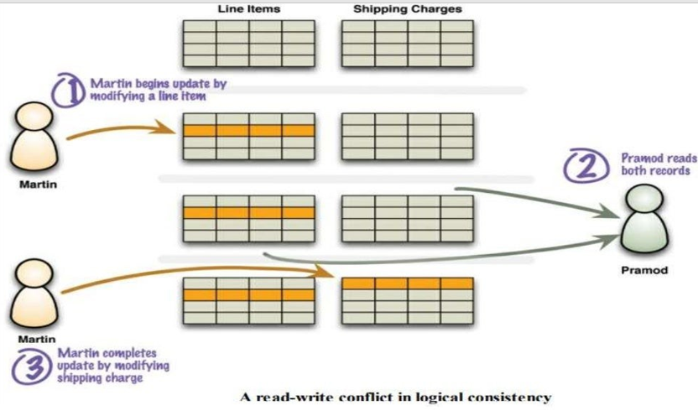
Read Consistency (Contd..)

Slide 56
Read Consistency (Contd…)
Inconsistent Read or Read-Write Conflict
Danger of inconsistency
Martin adds a line item to his order, Pramod then reads the line items and shipping charge, and then Martin Updates the shipping charge. Pramod has done a read in the middle of Martin’s Write.

Slide 57
Read Consistency (Contd…)
Given a Schedule S. T2 Could read a database object A, Modified by T1 which hasn’t committed. This is a dirty read, also known as logical consistency.
Inconsistent Read or Read-Write Conflict
“In, the field of databases, write-read conflict, also known as reading uncommitted data, is a computational anomaly associated with interleaved execution of transactions.”

Slide 58
Read Consistency (Contd…)
Logical Consistency :
To, ensure that different data items make sense together. To avoid a logically inconsistent read-write conflict, RDBMS supports the notion of transactions.
Example: Martin wraps his two writes in a transaction, and the system guarantees that Pramod will either read both data items before the update or both after the update.

Slide 59
Read Consistency (Contd…)
Inconsistency Window:
The Length of time inconsistency is present is called the inconsistency window.
“A NoSQL System may have a quite short inconsistency window. Usually less than a second.”

Slide 60
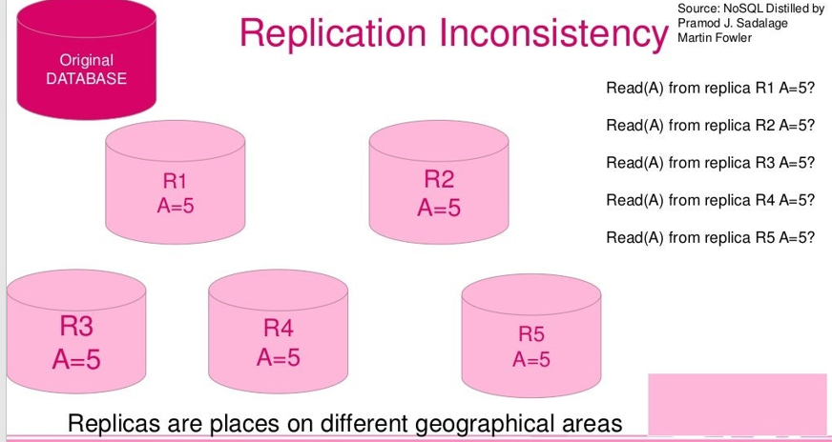
Read Consistency (Contd…)

Slide 61
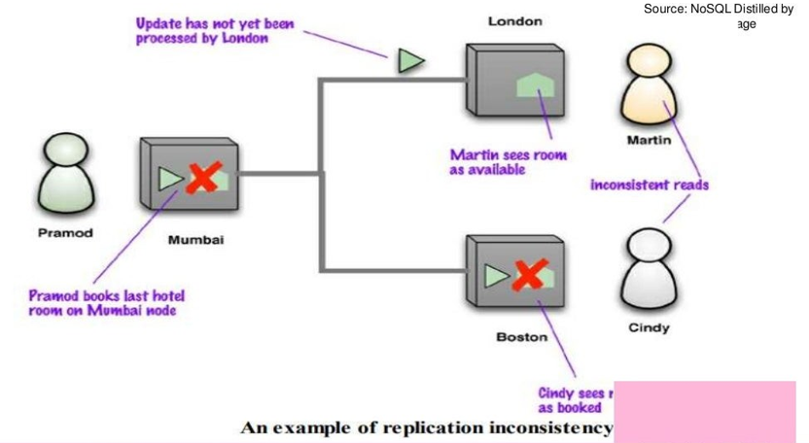
Read Consistency (Contd…)

Slide 62
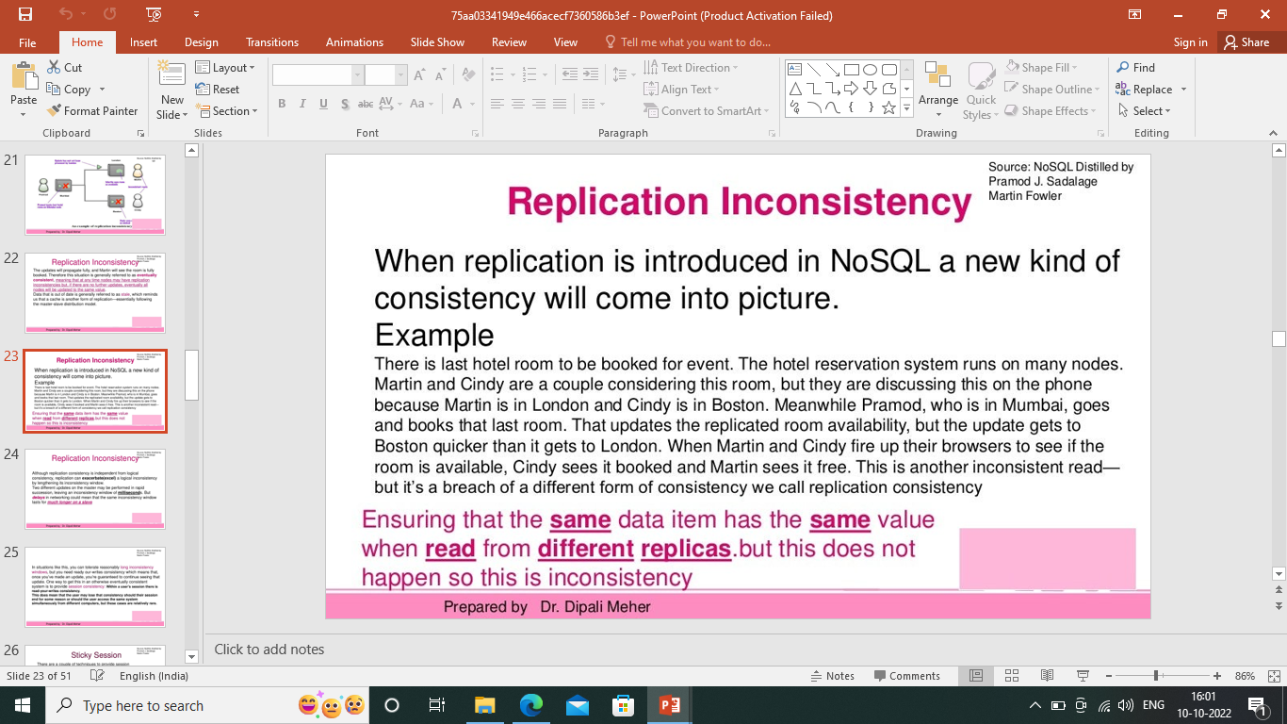
Read Consistency (Contd…)
The Updates will propagate fully, and Martin will see the room is fully booked. Therefore this situation is generally referred to as eventually consistent.

Slide 63
Read Consistency (Contd…)
Sticky Session :
There are a couple of techniques to provide session consistency. A common way, and often the easiest way, is to have a sticky session: a session that’s tied to one node (this is also called session affinity)
“A Sticky Session allows you to ensure that as long as you keep reading –your –writes consistently on a node you will get it for sessions too. The downside is that sticky sessions reduce the ability of the load balancer to do its job.”

Slide 64
Read Consistency (Contd…)
Version Stamps
Another approach for session consistency is to use Version Stamps and ensure every interaction with the data store includes the latest version stamp seen by a session. The Server node must then ensure that it has the updates that include that version stamp before responding to a request.

Slide 65
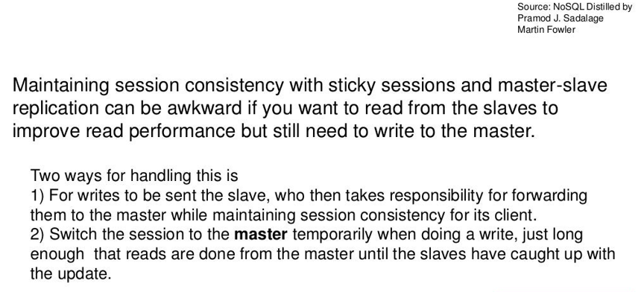
Read Consistency (Contd…)

Slide 66
Relaxing Consistency
Trading Off Consistency is a familiar concept even in single-server relational database systems. But, the principal tool to enforce consistency is the transaction.
Transaction systems usually come with the ability to relax isolation levels, allowing queries to read data that hasn’t been committed yet, and in practice we see most applications relax consistency down from the highest isolation level(serialized) in order to get effective performance.

Slide 67
Relaxing Consistency
Consistency is a Good Thing – but, sadly sometimes we have to Sacrifice it.
It’s always possible to design a system to avoid inconsistencies, but often impossible to do so without making unbearable sacrifices in other characteristics of the system.
As a result, we often have to trade off Consistency for something else.

Slide 68
CAP Theorem
CAP: Consistency, Availability, Partition Tolerance
Consistency: All the nodes see the same data item at the same time.
Availability: Every Request Received By a database node(not fail) should result in the correct response.
Partition Tolerance: The System Continues to operate despite arbitrary partitioning due to network failures.

Slide 69
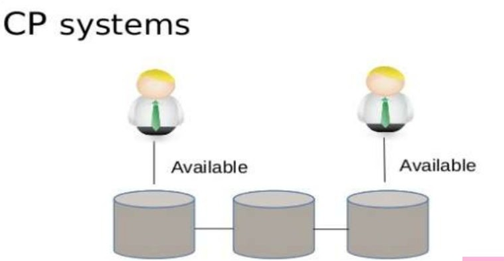
CAP Theorem (Cont’d..)

Slide 70
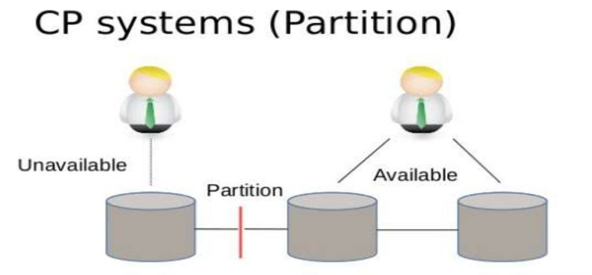
CAP Theorem (Cont’d..)

Slide 71
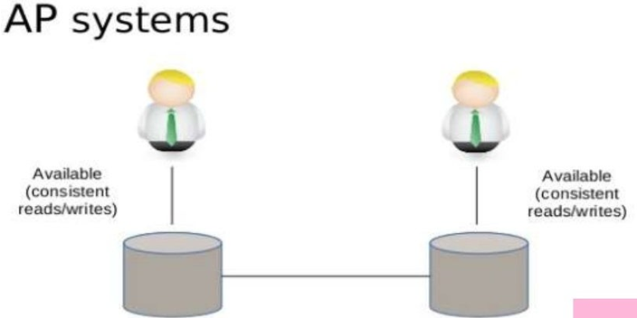
CAP Theorem (Cont’d..)

Slide 72
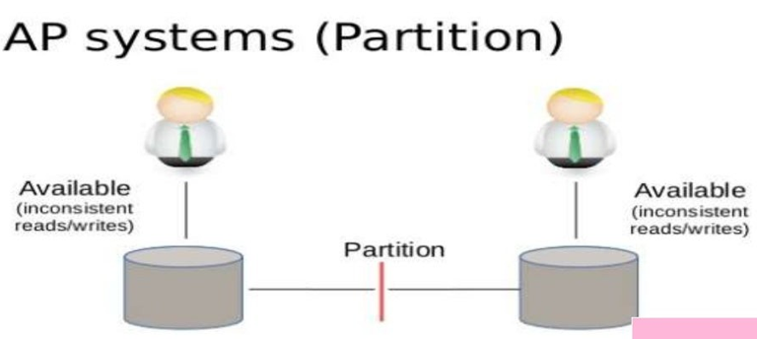
CAP Theorem (Cont’d..)

Slide 73

CAP Theorem (Cont’d..)

Slide 74
CAP Theorem (Cont’d…)
The CAP theorem is a tool used to make system designers aware of the trade-offs while designing networked shared–data systems.
Consistency: a guarantee that every node in a distributed cluster returns the same, most recent, and successful write. (Every Client has the same view of data)
Availability: Every non-failing node returns a response for all read and writes requests in a responsible amount of time.
Partition Tolerant: The System continues to function and upholds its consistency guarantees in spite of network partitions.

Slide 75
CAP Theorem (Cont’d…)
The c and a in acid represent different concepts than the c and a in the cap theorem.
CP (consistent and partition tolerance) : CP is referring to a category of systems where availability is sacrificed only in the case of the network.
CA (consistent and available): Single node DB servers categorized as ca systems. single node DB servers do not need to deal with partition tolerance.
AP (available and partition tolerant) : These are the systems that are available and partition tolerant but cannot guarantee consistency.

Slide 76
CAP Theorem (Cont’d…)
The correct way to think about the cap is that in case of a network partition ( a rare occurrence) one needs to choose between availability and consistency.

Slide 77
Summary
RDBMS: To Exhibit Strong Consistency By Avoiding all the various Inconsistencies.
NoSQL : CAP Theorem & Eventual Consistency.
Pessimistic Approach: Lock the data records to prevent conflicts.
Optimistic Approach: Detects Conflicts and Fix them.
To Get good consistency, you need to involve many nodes in data operations, but this increases latency. So, you often have to trade off consistency vs latency.
The CAP Theorem states that if you get a network partition, you have to trade off the availability of data vs consistency.

Slide 78
Summary (Cont’d…)
Durability can also be a trade-off against latency, particularly if you want to survive failures with replicated data. You do not need to contact all replicants to preserve strong consistency with replication; you just need a large enough quorum.

Slide 79

Case Studies
.

Slide 80

Case Studies (Cont’d…)
.

Slide 81

Case Studies (Cont’d…)
.

Slide 82

Case Studies (Cont’d…)
.

Slide 83

Case Studies (Cont’d…)
.

Slide 84

Case Studies (Cont’d…)
.

Slide 85

Case Studies (Cont’d…)
.

Slide 86

Case Studies (Cont’d…)
.

Slide 87

Case Studies (Cont’d…)
.

Slide 88

Case Studies (Cont’d…)
.

Slide 89


